Slide 1


The Evolution of E-Commerce
History Repeats Itself (again)
Daniel V. Klein
dan@klein.com

Slide 2
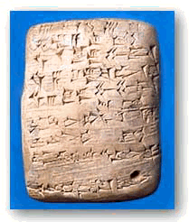

In the beginning…
…the Earth was without form, and void; and darkness was on the face of the deep.
Notes:
The original currencies were property – sheep, oxen, grain, and textiles, because they were valuable. Once life was no longer strictly hand-to mouth, currencies abstracted in different ways – ornamental textiles, ochre, precious metals and jewels, rare shells, rounded rocks (Yap island). Wealth was having a lot of what other people wanted. Commerce was trading what you had for what you wanted.
Transactions based on promises - Venice: flags seen from towers as ships approached
Space shuttle more than worth it’s weight in gold

Slide 3
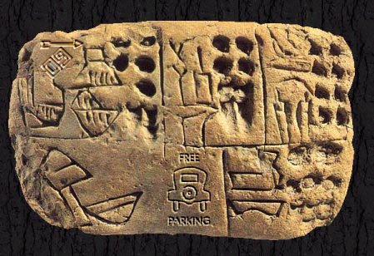
Notes:
This is not a talk about facts alone. It is about history: observation, inference, prediction, guesswork and ratiocination (Sherlock Holmes: detective work)

Slide 4
Where E-commerce began
Telegraph (demonstrated in 1844) spread with the railroads in the mid 1800’s
  Coast-to-coast by 1861
  Ordering goods and services remotely
  Wire transfer of funds (backed by physical transit later on by Express)
  The promise of goods and of payment
Transatlantic Cables – 1857-1866
Notes:
Cables transmitting at 50 baud
Online Newspapers being read in 1939
OED, on a railroad line: http://dictionary.oed.com/public/news/0109.htm

Slide 5
Electronic Genesis
Until very recently, only computer people had computers
Started to change in the 1980’s
Paradigm shift in 1995 – the World Wide Web
Notes:
Computer people used regular commerce – reverse alchemy, they turned gold into sand (silicon)
In 1980’s, “normal” people started getting computers, and in 1995, the web started to take off. Suddenly, critical mass was reached.
In 6 years, the world has changed – completely and irreversibly

Slide 6
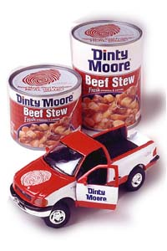
Checks & Credit Cards
In the early 19th Century, there were cheques
Credit cards only started to
become widely accepted in
the 1950’s
Notes:
Early e-commerce – you manufacture a marker for your account
Limited acceptance, based on trust or membership
Diner’s club, Dinty Moore as a restaurant reviewer

Slide 7
Evolution & Natural Selection
Natural selection works in nature
It also works in computers & business
  Digital Equipment Corporation
  Microsoft
  Linux
It also works in politics and e-commerce
Notes:
DEC – extincted by politics
Microsoft – big dinosaur, the comet is coming
Linux – Little furry rodents will fill ecological niches
Politics you know much better than I do!

Slide 8
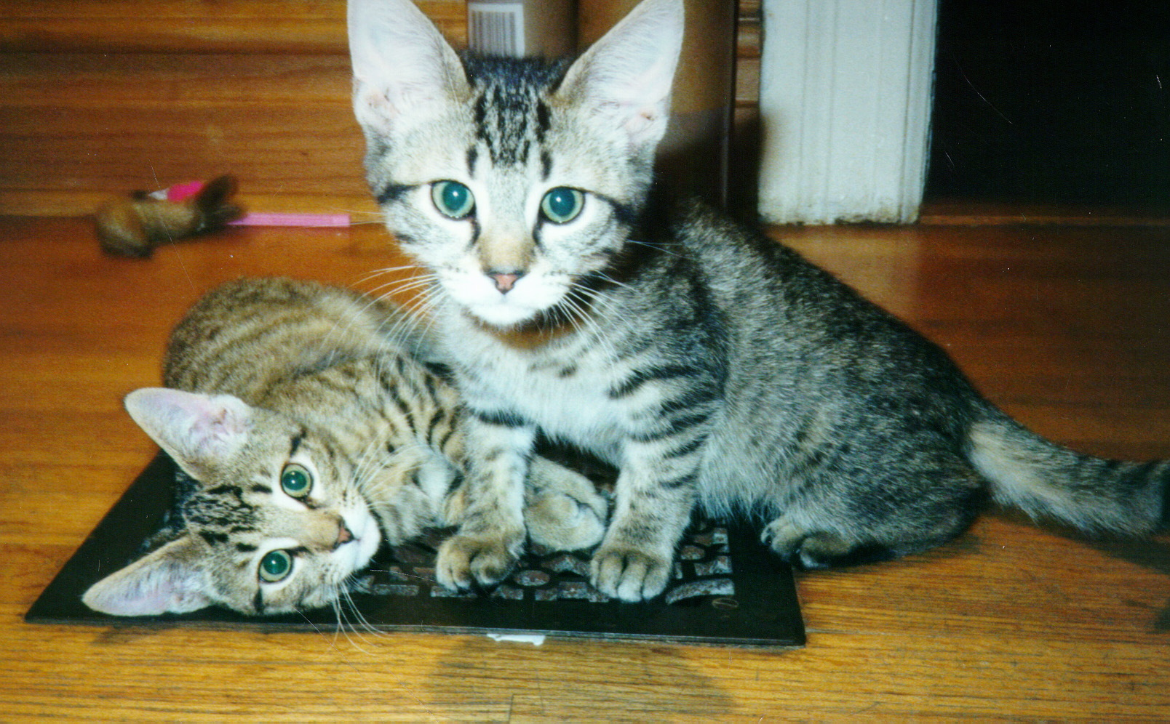
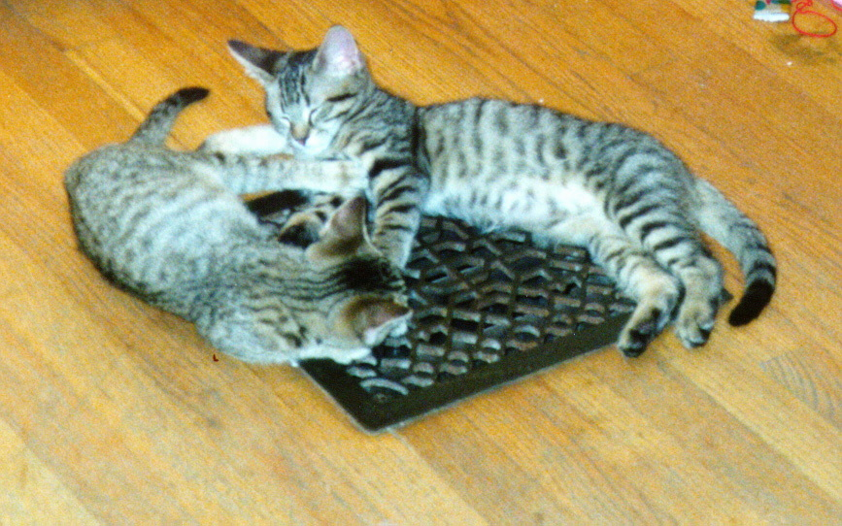

Slide 9

Church and State
Taxation is okay
  You have to pay for armies
Killing is okay
  They are infidels
Theft is okay
  Spoils of war
Lending money at interest is bad
  A venial sin!
Notes:
Other bright ideas
Carrying charges - interest that isn’t interest (see also tax refund checks and check advance)
Gregory VI, whores in the Vatican
Jakob Fugger, 6M guilders in 1425 (7' x 8' x 8' … 6 of those!)
private armies in the 14-15th century, roving mercenaries
Can't fight 'em, they can burn you at the stake

Slide 10
You’ll do it my way
Big companies try to set rules
Need special accounts with special banks, everyone uses my bank (or pay extra)
Special hardware attached to your computer
Place order online, call company with credit card information, exchange PIN numbers
Notes:
Anyone can do it - New Age religions

Slide 11
Company Store, Company Scrip
People work, are paid in company scrip
Can use scrip to shop at company store
Scrip has theoretical cash value
  Cannot readily exchange for dollars
  Company store engages in price gouging
  Employees are slaves
Notes:
There were exceptions to the slavery rule, and companies gave employees a better deal (viz. The army’s PX, although the currency is usually dollars)

Slide 12
Cybercash / Cyberwallet
You buy cyberdollars with real dollars
Clients buy services with cyberdollars
Companies accept cyberdollars as payment
Companies sell cyberdollars to get real dollars
Transaction fees when you exchange
Notes:
Last item – sounds like the Euro :-)

Slide 13
Private Banks
In 17th – 19th centuries, banks were private
Uninsured
  If your bank was robbed, you lost your money
  If your bank folded or absconded, you lost
Largely unrelated
  No ATMs, elaborately coded letters of credit
Notes:
Bank of England was originally the Bank of the Crown, not the English People.
Mention S&L crisis – new rules, new banks, new thieves, new losses
Who suffers? Little guy!
Exceptions: credit unions, rare national banks (Scotland)

Slide 14
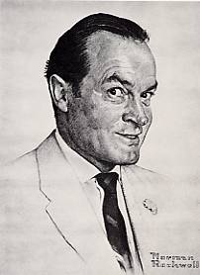
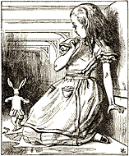
Cryptography
Secure communication is the key
Security is keeping a secret
  Can you hear it?
  Can you understand it?
  Can you reproduce it?
Notes:
Ciphers, steganography, and cryptography have been around for a long time
Caesar used ROT-3, Enigma, Purple, etc., private codes used by agents.
Crypto was used for expensive things (tactics, big movements, big monetary transactions, because crypto was expensive). Only recently, when it becomes cheaper/easier, is it endemic in use.

Slide 15
Purchasing Agents
You hire agent, give letter of credit
Agent goes on road
  Sees goodies
  Sends samples
  You send okay
  Buys on credit, ships goodies
  Credit cleared later
Notes:
Based on long history of trust, obscurity of secrets, and personal(often familial) relationships between banking houses
NOTE: complicated transactions work just fine for: RSA, AFS, Web Certificates… - that’s because the work transparently.

Slide 16
First Virtual
Client signs up with credit card
  By telephone
When buying, submits form
  Server sends email to FV
  FV sends email to client
  Client sends email to FV
  FV sends email to server
  (Can view product before paying!)
Notes:
Same day service in a nanosecond world
Exception to the rule – PayPal - more elaborate than just paying cash, but easy enough for almost any fool to use.

Slide 17
Industrial Revolution
You make stuff, you want to sell it
Unless you are big, you get robbed
  Hire thugs
  Cost of doing business
Unless you are big, transactions are small
  and local or highly specialized
Wholesalers / retailers
Notes:
Merchant class has been around a while (Belgium 15th century), but rarely on a big scale. Controlled by warriors or politics; rise of the guilds.
Hiring thugs was a cost of doing business; losing money was a cost, too
Small transactions are also local and/or highly specialized
Industrial revolution was much more than a revolution of industry. Involved class structure, sales structure, communication, finance, etc. Introduced the middle class, allowed class shifting by brains and not just brawn. Andrew Carnegie, William Randolph Hearst. Earlier examples in Europe.

Slide 18
E-Commerce Revolution
If you want to sell, you need a merchant account
  Have to be big, need credit history, nope - sell on trust, send me a check, get screwed
  Don’t have to be big, just pay a lot, hard to interface to banks
Wholesalers
  Have merchant account, take 15%, take risks
  Enable lower class to sell to world
Notes:
Selling specialized widget, hoping the tourist comes by to buy the matrioshka (vs. selling it to a wholesaler) - the whole concept of blat
Paypal, exception again, makes money on the float

Slide 19
Same Problems, Different People
Large number of credit card wholesalers
  Requires lots of work
  Requires lots of security
Mergers and acquisitions
Survival of the fittest, fattest, fastest
Notes:
Fittest == best
Beta/VHS
Fattest == pay a lot to market your bad idea
Windoze
Fastest == first to market
Not necessarily the best
Not necessarily the ultimate winner
Mergers: Amtrak & ConRail; AT&SF, P&LE, C&N;
Metro; BMT, IRT, IND
Privatization and Nationalization

Slide 20
What’s Next?
Microtransactions
  Pay as you go (or use)
  Utility service analogy
  Rent with utilities included
Currently not cost effective
  Credit card transactions too expensive
  Tracking and reporting issues
Notes:
Accumulation of transactions by Google bill every month, or bill per transaction
Maybe yes, maybe no
Why did AOL go to unlimited use?

Slide 21
So, nu?
There is no difference between commerce and e-commerce
Electronic transactions are just a different type of payment
Protocols have to fit human needs and human models – not the other way around
Your customers are not geniuses
Notes:
E-commerce is just selling stuff electronically, it is not (necessarily) selling electronic things.
So if you have a digital wallet, you need a way to look into it, or have mom lend her son $10, or give kids an allowance
Losing your wallet does not mean you lose your savings – just your portable cash. Losing your Java-ring should mean the same thing – it should not mean losing your identity!

Slide 22


Slide 23
Okay, what is for sale?
Physical media
  Books, parts, cars, music, antiques, junque, etc.
Virtual media
  Programs, memberships, searches, greeting cards, money, etc.
Advertising
  Anyone can be a publisher!

Slide 24
Physical
Barnes & Noble, L.L.Bean, LandsEnd, Clinique, Camera World
Books.com, buy.com, pets.com, groceries.com, wine.com, sparks.com
Amazon.com, PayPal.com
Notes:
1st set: Started selling physical, moved into electronic commerce
2nd set: Started business as a new physical mover of things
3rd set: the lucky one, and move money - no investment in merchandise or warehouse space
Note: first item in each bullet are books

Slide 25
Virtual Media
Sell once
  Buy a program (or picture, or license)
Sell repeatedly (monthly/annually)
  Buy a membership in a site
  Mainly adult-site memberships, others exist
Sell sporadically (access/use)
  Buy information per search
  Moving money (PayPal, IBill)
Notes:
Pictures on a CD, buy right to use them in your work (stock photos)
Memberships - non-adult, to buy in a market place
Prothonotary’s office

Slide 26
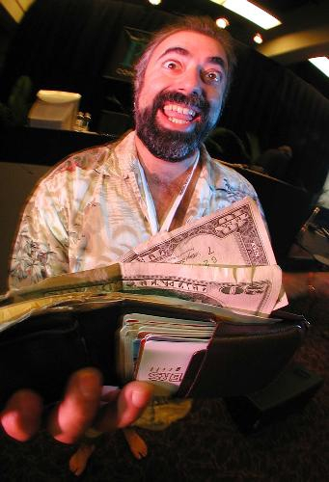
Advertising
Anyone can advertise!
  Selling ads is main motivation
  of free sites
  Not all ads are banners!
Different payment schemes
  Per-impression
  Per-click
  Per-sale
Notes:
Free sites:
Adult site ads (us) $14,000/month
Exit traffic
Buy a keyword: sex 330,300 impressions/day $4954.50/day
fuck 23,500 impressions, $352.50/day
Lycos: Nude Pictures of Pamela Anderson and Monkey
Voyeur.com
Selling lists of searched words to ad companies

Slide 27
Paying for Ads
Per-impression
  Fairest to advertiser (bandwidth costs), but advertiser must trust publisher
Per-click
  Fairest to both (both can track traffic, publisher can pull unsuccessful ads), but susceptible to abuse by both sides (click-bots and trimming by “uniques”)
Per-conversion
  Fairest to advertiser (pay only for results), but publisher must trust advertiser
Notes:
Click-bot, simple 6-line script

Slide 28
Two Distinct Marketplaces
“Adult”
  5–15% click-through rate
  0.1–1% conversion rate
  Lots of traffic from little advertisers
“Mainstream”
  0.25–1% click-through rate
  2–10% conversion rate
  Most traffic through big advertisers
Notes:
What could PlasticFantastic advertise?
A camera site could advertise cameras (not much traffic, though)
A search engine will advertise cameras (lots of potential traffic, easily directed)

Slide 29
Payment Schemes
Per Impression
  Only way on big mainstream advertisers
Per Click
  Few adult sites use it any more – lots of abuse
  Many mainstream sites use it
Per Conversion
  Mainstream and adult
Notes:
Per click still paid with sliding scale based on conversions
Per conversion – pay more than one month’s income for signup
signup vs. retained income (don’t mention yet - 2 slides from now)

Slide 30
Simple Click-bot
#!/usr/bin/perl
use HTTP::Request;
use LWP::UserAgent;
$ua = new LWP::UserAgent;
$ua->agent("Mozilla/4.76");
$req = new HTTP::Request(GET =>
"http://tracker.loser.com/count?id=1a47cb3");
while (1) {
$ua->request($req);
sleep int rand 16;
}
Notes:
About 10,000 clicks/day

Slide 31
Per-Conversion Payment
Different pay-out schemes (depending on business being advertised)
  Per-referral fee
  Per-signup fee
    A fraction of sales
      One-time
      Recurring
    A fraction of anticipated sales
Notes:
Per referral: what does it cost to get a qualified person? Financial companies...
Payout of more than signup as commission:
Web
Insurance companies

Slide 32
Not the end…
Information super-highwayman
  New kinds of sales
  New kinds of commerce
  New kinds of theft
  Different kinds of insurance
  Adaptive restrictions
Back to the Wild West!
Notes:
Brinks, Wells Fargo, riding shotgun
1852 - from the beginning: signs on the first office in San Francisco proclaimed it an “Express and Banking House.” The first ads in 1852 listed the banking services: buying and transporting gold; cashing checks; selling bank drafts payable in other states and overseas [known as exchanges]; accepting deposits and making loans. In the 19th Century, Wells Fargo maintained large banking offices in the major cities of the West, as well as in New York. Wells Fargo's Express network brought its banking services virtually anywhere.
In 1918, the federal government assumed operations of the nation's railroads and express as a wartime measure. Wells Fargo, American Express, Southern Express, and all other express companies' offices, equipment and employees were merged into one vast American Railway Express. The Wells Fargo name disappeared from express wagons and offices at 10,000 locations worldwide, ending an era in American transportation history. At the end of the First World War, there was\ mutual agreement to continue with a unified express company, and the Railway Express Agency continued until 1972. American Express built on its financial services for travelers.
From the wild west arose the biggest, most powerful nation… of narrow minded, egocentric, idots. See that it doesn't happen to e-commerce.

Slide 33
It was the best of times, it was the worst of times.
Instant gratification
  Assessing customer feedback
  Assessing ad effectiveness
Loss of privacy
  Voluntary loss
  Involuntary loss
Loss of anonymity
Big Brother is already watching you!
Notes:
What is your privacy worth?
Fingerprints
Mother’s maiden name
SSN
Some folks are willing to sell their own secrets
Giant Eagle advantage card
Amazon wish list

Slide 34
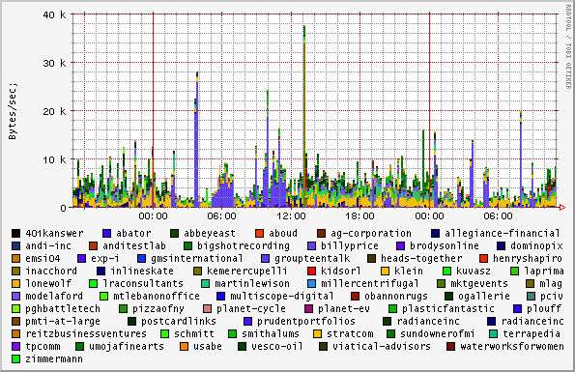
Mainstream Sites - 1 day use

Slide 35
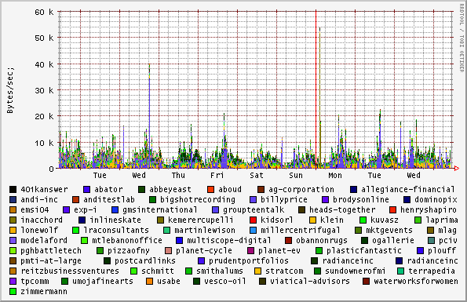
Mainstream Sites - 1 week use

Slide 36
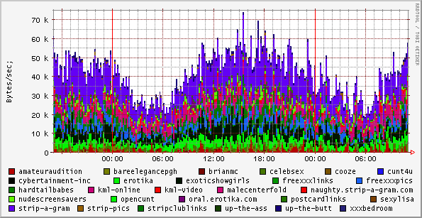
Adult Sites - 1 day use

Slide 37
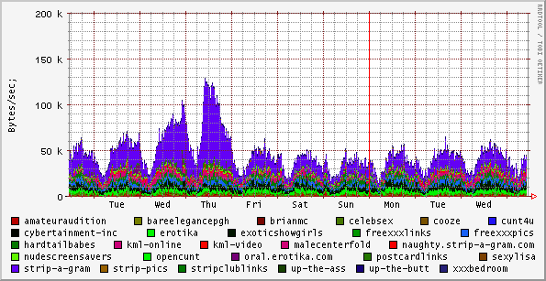
Adult Sites - 1 week use

Slide 38
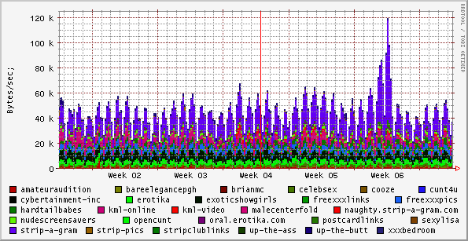
Adult Sites - 1 month use

Slide 39
So… what’s next?
Read science fiction!
  Chester Gould (<1935) – wrist radio
  Frederick Pohl (1965) – joymaker
  John Brunner (1974) – information society
  Robert Heinlein (1959) – computer immersion
  implanted computers, crypto, global networks, intelligent agents, nanobots…
Notes:
Pohl – Age of the Pussyfoot
Vinge – True Names
Brunner – The Shockwave Rider
Toffler – Future Shock
Walter John Williams, Gibson, Heinlein, Rudy Rucker, Niven, Pournell…
Pay for vending machines through cel phone (Australia, Finland) - microtransactions built in!
Started @ Stanford (early 1970’s) using your computer login (beer or not depending on age)

Slide 40
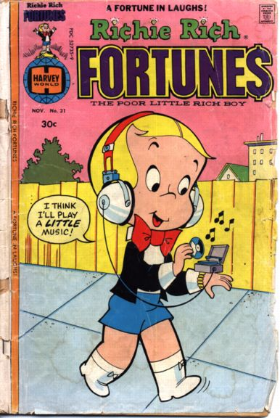
Notes:
1976
In 1964(ish), Danish inventor Karl Krøyer came up with the idea to raise a sunken ship using styrofoam balls. He was denied a patent because the idea (w/ping pong balls) had appeared in Donald Duck in 1949 (http://stp.ling.uu.se/~starback/dcml/story/W+WDC+104-02)

Slide 41
The Evolution of E-Commerce
History Repeats Itself (again)
Daniel V. Klein
dan@klein.com

